Slide 1
BTH – Introduction to Ansible
Ansible for Networks and Systems Automation
Hector Serrano (hecserra@cisco.com)
Consulting Engineer
2021 - May

Slide 2
FAQS
Yes, session is being recorded and will be shared
Yes, presentation will be shared
For every 50 minutes of session there will be a 10 minutes break
The duration of this session is no more than 2 hours. The session may get extended due to questions
You can ask during the session, just please raise your virtual (not your physical ;-) ) hand on the WebEx chat first
Introduction level to Ansible. Zero knowledge assumed
Familiarity with Linux is assumed
If you are an advance Ansible user, then you may or may not learn something new on this session

Slide 3
Who I am
Network Engineer
Cisco TAC > Cisco PS
In TAC mostly doing CLI troubleshooting of Routing Protocols in IOS, IOS-XE, NX-OS
In PS focus on Data Center Networking portfolio (Cisco ACI, Multi-Site Orchestrator for ACI, VXLAN in N9K, DCNM for VXLAN, etc.)
Nowadays mainly focused on design and implementation projects related with Cisco ACI.
I’m no Sysadmin, no Software Developer, no DevOps engineer ☺

Slide 4
Who you are...
Brief Introduction
Do you already have any use case in mind to automate/script any task with Ansible?

Slide 5
Agenda
What is Ansible? / Why Ansible? | Variables, conditionals and loops
Installing Ansible | Jinja2 Templating
Cisco devices Sandbox | Roles and Ansible Galaxy
YAML format, inventory files and Vault | Ansible for Network Driven Programmability
Playbooks and modules | Last demo of the day: Deploying full stack application with Ansible

Slide 6
What is Ansible? / Why Ansible?
Infrastructure automatization
Easy
Declarative approach
Agent-less

Slide 7


Abstraction of Python
No need to learn programming to use Ansible
Re-usability
Easy to share existing modules
Leverages YAML
Easy to understand, create and modify

Slide 8




Managed Nodes
Control Node
Agentless
”Push” approach
SSH
enabled
Run puppet Master
Run puppet Agent
Requires Agent
”Pull” approach

Slide 9
Installing Ansible

Slide 10
Installing Ansible
Control node (the machine that runs Ansible)
Linux distribution, Mac OS X, BDS and alike
Python 3 (OK, Python 2 as well but remember it is already deprecated)
RHEL, CentOS, Fedora, Ubuntu, Debian, Gentoo, FreeBSD, macOS, Solaris, Arch Linux, Slackware Linux, Clear Linux...
https://docs.ansible.com/ansible/latest/installation_guide/intro_installation.html
Windows is not supported as control node.
http://blog.rolpdog.com/2020/03/why-no-ansible-controller-for-windows.html
But you may try with: (none of these covered during this session)
Windows Subsystem for Linux (WSL)
Virtualizing Linux on Windows (VMware, Virtual Box, etc)
Running Containers on Windows...

Slide 11
Installing Ansible
Managed nodes (the machines that Ansible is configuring)
SSH / SCP (sometimes SFTP)
Linux servers require Python installed
Network devices just need SSH enabled
Some Ansible modules have additional requirements...
Yes, here Windows could be managed by Ansible...
Windows 7, 8.1, and 10
Windows Server 2008, 2008 R2, 2012, 2012 R2, 2016, and 2019
PowerShell 3.0 or newer and at least .NET 4.0
A WinRM listener should be created and activated
https://docs.ansible.com/ansible/latest/user_guide/windows_setup.html
Installing Ansible
https://docs.ansible.com/ansible/latest/installation_guide/intro_installation.html

Slide 12
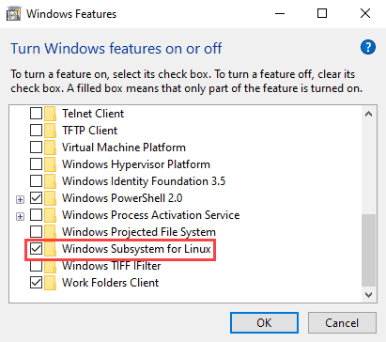
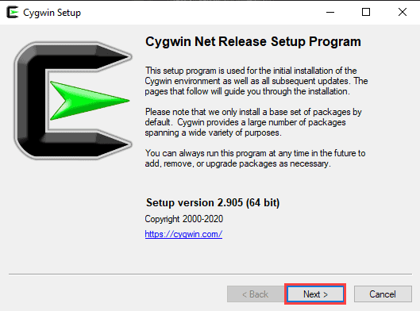
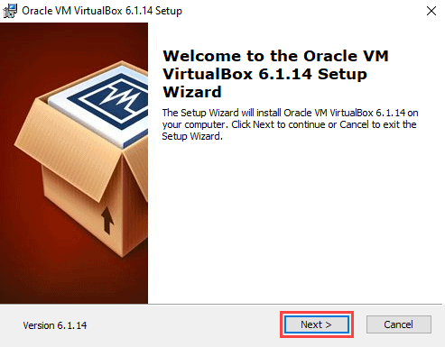
Installing Ansible on Windows ... Tutorial
Method 1: Using Cygwin
Method 2: Using a Linux Virtual Machine
Method 3: Enabling Ubuntu on Windows 10
https://phoenixnap.com/kb/install-ansible-on-windows

Slide 13
DEMO: Installing Ansible on Ubuntu 21.04

Slide 14

Cisco Devices Sandbox
DevNet Always On Sandboxes!

Slide 15
Cisco Devices Sandbox https://devnetsandbox.cisco.com/RM/Topology
CSR1000V Host: ios-xe-mgmt.cisco.com SSH Port: 8181 NETCONF Port: 10000 RESTCONF Ports: 9443 (HTTPS) Username: developer Password: C1sco12345 | Nexus 9000v Host: sbx-nxos-mgmt.cisco.com SSH Port: 8181 NETCONF Port: 10000 NXAPI Ports: 80 (http) & 443 (HTTPS) RESTCONF Port: 443 (HTTPS) Username: admin Password: Admin_1234!
IOS XRv 9000 Host: sbx-iosxr-mgmt.cisco.com SSH Port: 8181 NETCONF Port: 10000 XR bash Port: 8282 Username: admin Password: C1sco12345 | Cisco ACI simulator URL: https://sandboxapicdc.cisco.com/ Username: admin Password: ciscopsdt

Slide 16
YAML format, inventory files and Vault

Slide 17
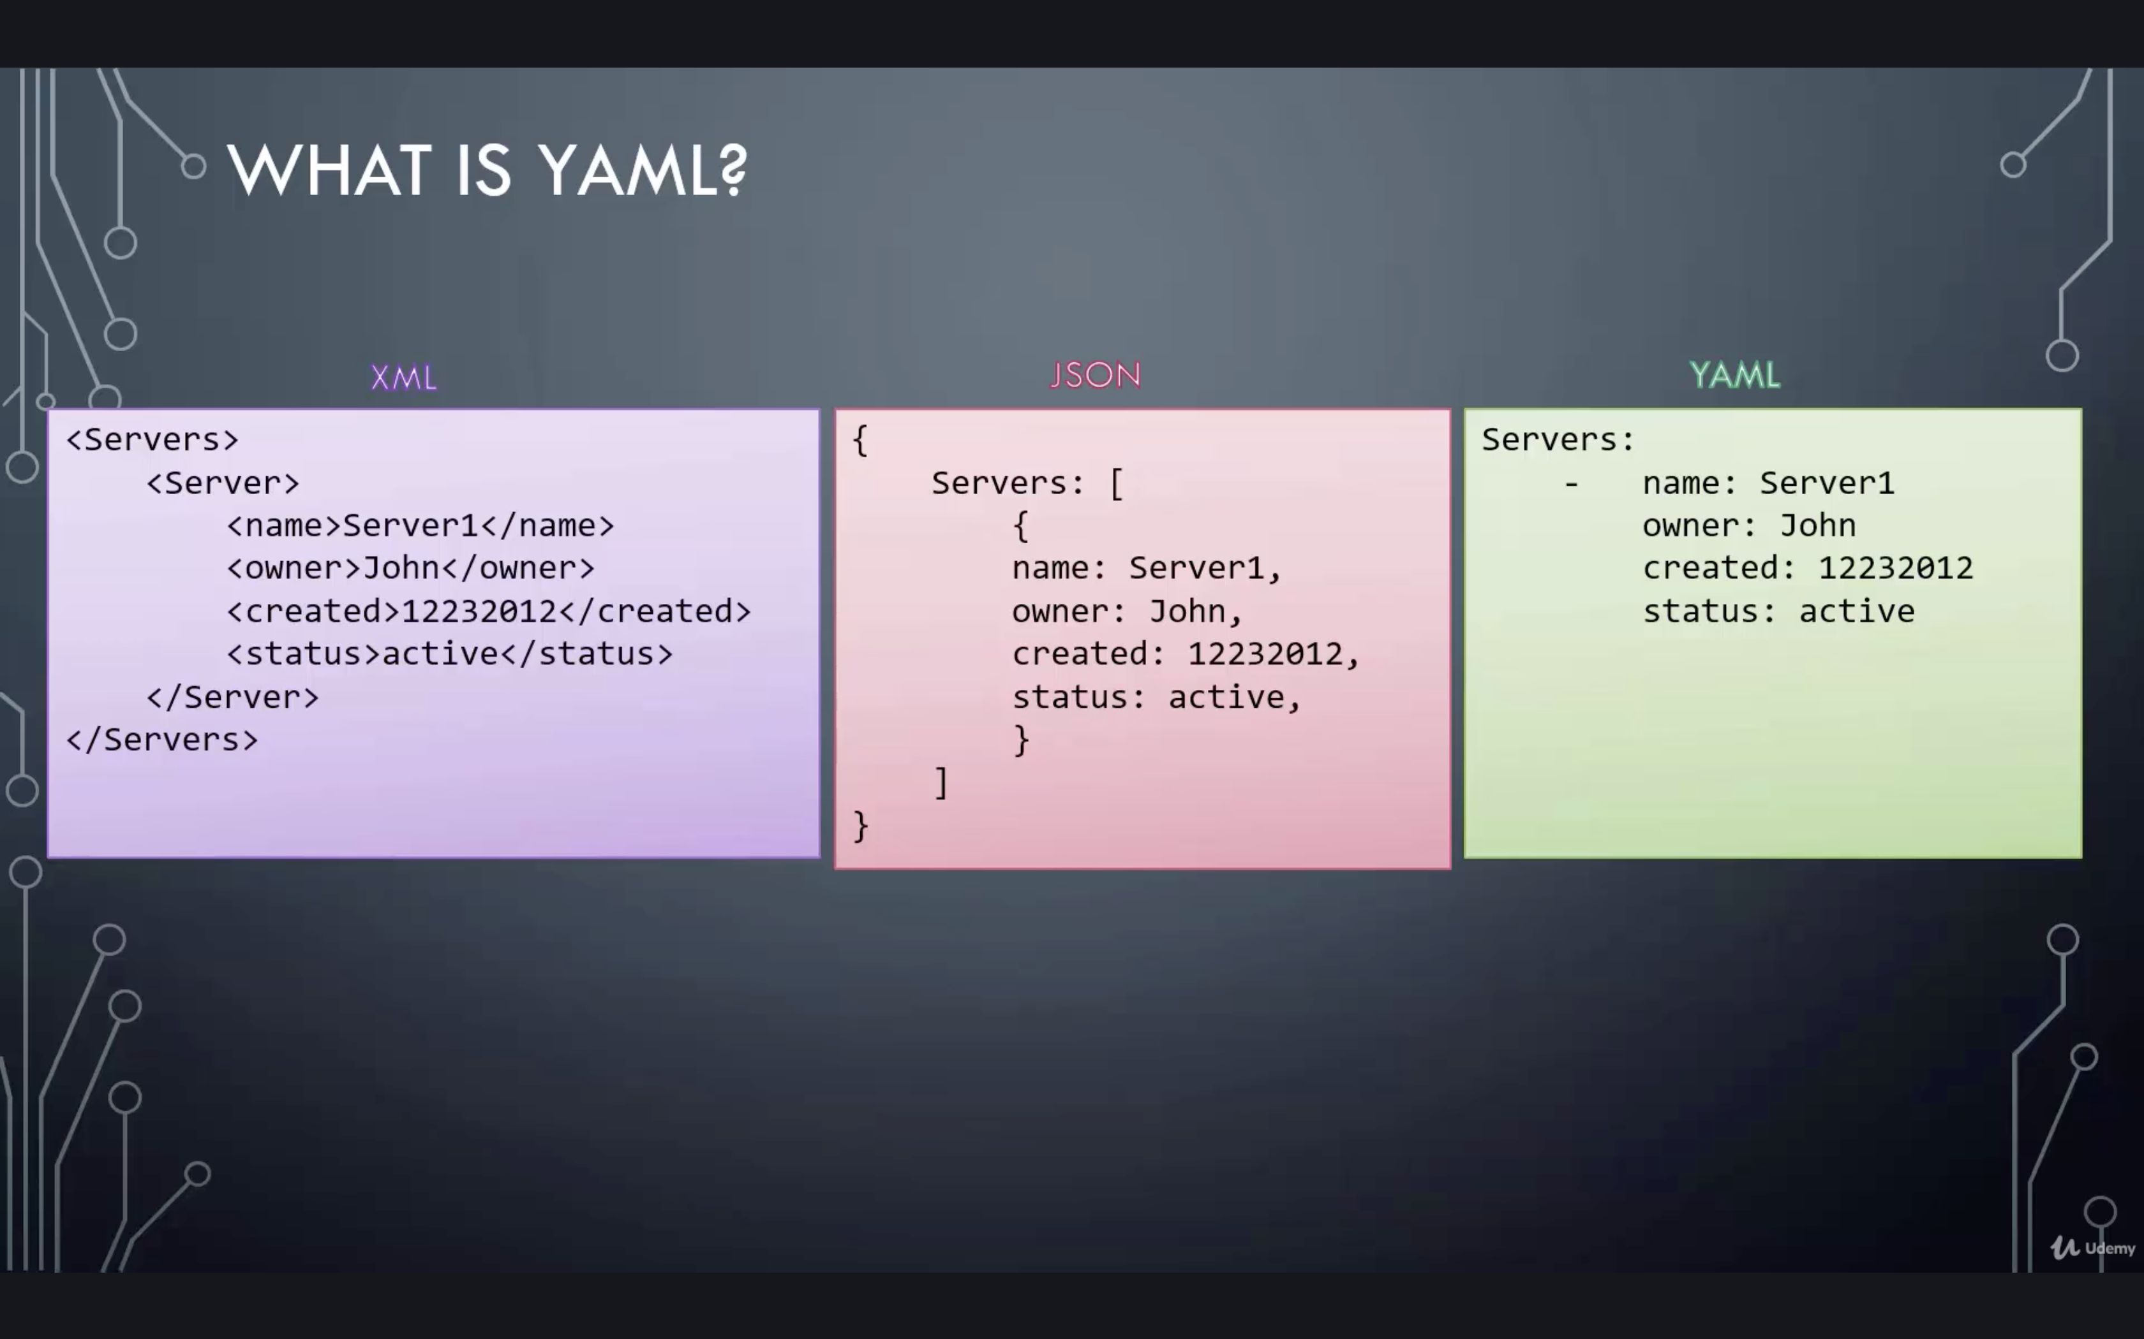
YAML format

Slide 18
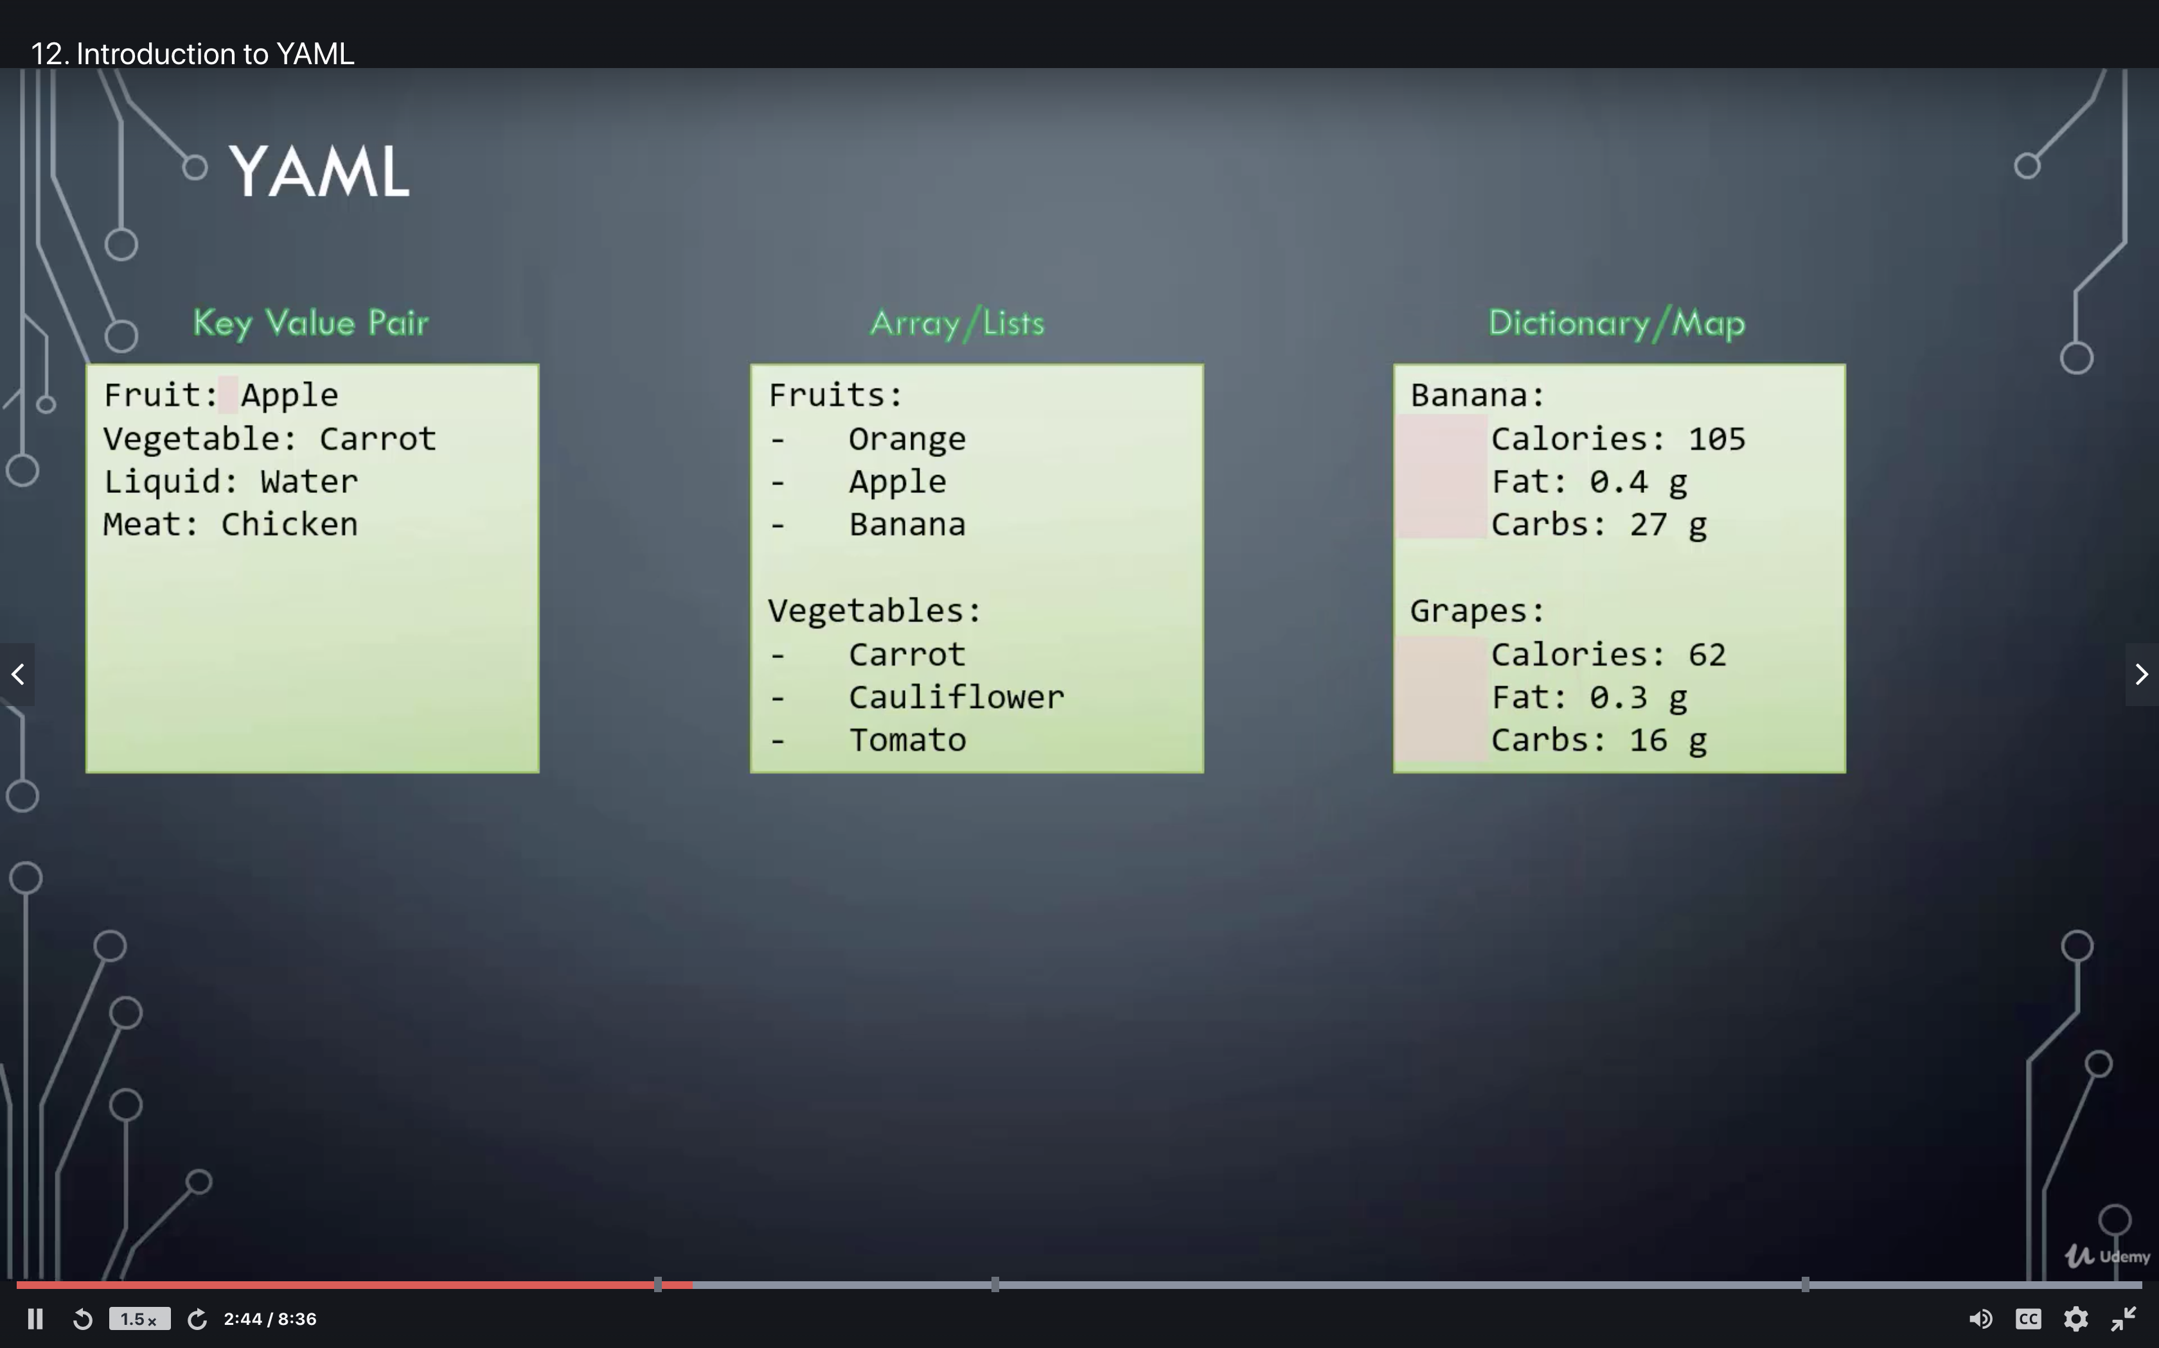
YAML format

Slide 19
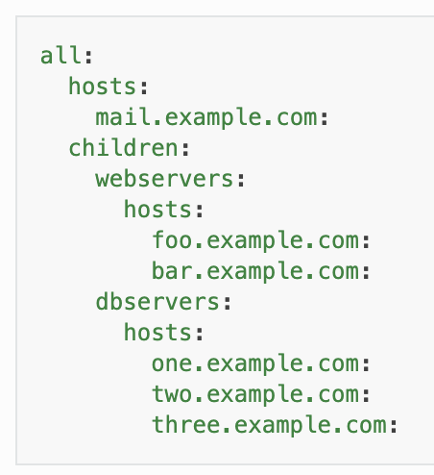
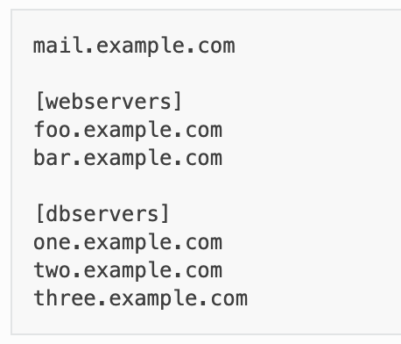
Inventory file
INI format | YAML format
https://docs.ansible.com/ansible/latest/user_guide/intro_inventory.html

Slide 20
Ansible Vault
$ ansible-vault encrypt inventory
$ ansible-vault decrypt --ask-vault-password inventory
$ ansible-vault edit --ask-vault-password inventory
$ ansible-vault view --ask-vault-password inventory
$ ansible-vault rekey --ask-vault-password inventory
$ ~/.vault_key
$ chmod 600 ~/.vault_key
--vault-password-file ~/.vault_key

Slide 21
Ansible Configuration Settings
$ ansible-vault encrypt inventory [--vault-password-file ]
$ ansible-vault decrypt inventory [--ask-vault-password | --vault-password-file ]
$ ansible-vault edit inventory [--ask-vault-password | --vault-password-file ]
$ ansible-vault view inventory [--ask-vault-password | --vault-password-file ]
$ ansible-vault rekey inventory [--ask-vault-password | --vault-password-file ]
$ echo mypassword > ~/.vault_key
$ chmod 600 ~/.vault_key
--vault-password-file ~/.vault_key
export ANSIBLE_VAULT_PASSWORD_FILE=~/.vault_key
https://docs.ansible.com/ansible/latest/reference_appendices/config.html

Slide 22
Playbooks and modules
Ansible and Cisco https://www.ansible.com/integrations/networks/cisco
Cisco ACI
Cisco AireOS
Cisco IOS
Cisco IOS XR
Cisco Meraki
Cisco NSO
Cisco NX-OS
Cisco UCS

Slide 23
Ansible commands
# demo0 $ ansible all -i ios-xe-mgmt.cisco.com:8181, -c network_cli -u developer -k -m ios_facts -e ansible_network_os=ios
# demo1
$ playbook.yaml
$ ansible-playbook -i ios-xe-mgmt.cisco.com:8181, -u developer -k -e ansible_network_os=ios demo1_playbook.yaml
https://docs.ansible.com/ansible/latest/network/getting_started/first_playbook.html

Slide 24
Common issues / Troubleshooting
Always start small. Start with a “Hello World” and add complexity slowly.
Variables are not read.
Inventory is not read.
Look at configuration file.
Debug with:
Usual fix is to add a Variable either as global/system variable, as par of the playbook or in ansible.cfg file
Error is coming from Ansible or from target device?
$ ansible-playbook <playbook_name> -i inventory –vvvv verbose mode (-vvv for more, -vvvv to enable connection debugging)

Slide 25

Jinja2 Templating
Template Designer Documentation
https://jinja.palletsprojects.com/en/2.11.x/templates/

Slide 26
Questions?

